Slide 1
Organizing and Staffing

Slide 2
Organizing is…
The identification and classification of required activities.
The grouping of similar activities necessary to attain objectives.
The assignment of each group to a manager with the authority necessary to supervise it.
The provision for coordination horizontally (on the same or a similar organizational level) and vertically (e.g., between corporate headquarters, division, and department) in the organization structure.

Slide 3
The Logic of Organizing
  Establishing enterprise objectives
  Formulating supporting objectives, policies, and plans
  Identifying, analyzing, and classifying the activities necessary to accomplish these objectives
  Grouping these activities in light of the human and material resources
  Delegating to the head of each group the authority necessary to perform the activities
  Tying the groups together horizontally and vertically, though authority relationships and information flows.

Slide 4
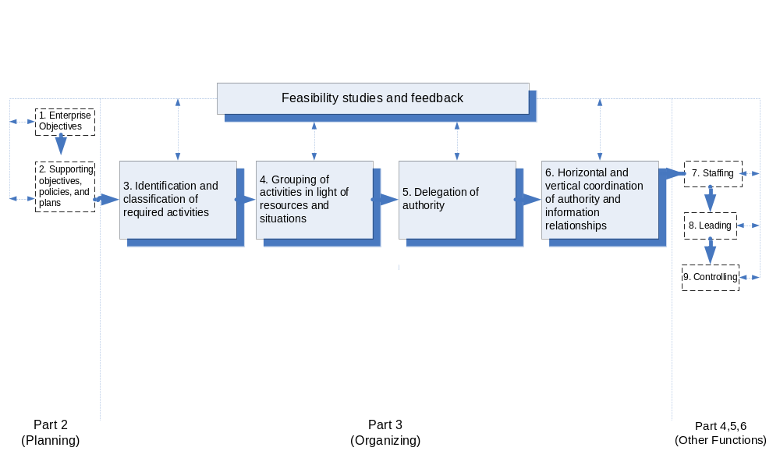
The Organizing Process

Slide 5
Organization
It is a formalized intentional structure of roles or positions.
It includes all the behaviors of all participants.
It is the total system of social and cultural relationships.

Slide 6
Formal Organization
Formal Organization means the intentional structure of roles in formally organized enterprise.
A formal organization must be flexible.
Individual effort in group situation must be channeled toward group and organizational goals.

Slide 7
Informal Organization
It is a network of interpersonal relationships that arise when people associate with each other.
It can also be described as any joint personal activity without conscious joint purpose, although contributing to joint results.
Thus, informal organizations—relationships that do not appear on the organization chart—might include the machine shop group, the sixth floor crowd, the Friday evening bowling gang, and the morning coffee “regulars”.

Slide 8
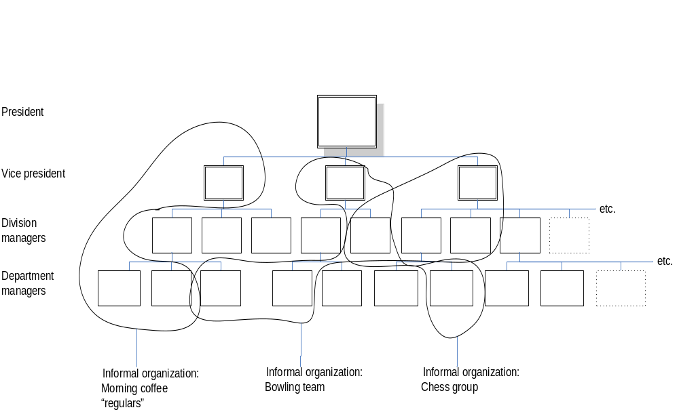
Formal and Informal Organizations

Slide 9
Organizational Division: The Department
One aspect of organizing is the establishment of departments.
A department is a distinct area, division, or branch of an organization over which a manager has authority for the performance of the specified activities.

Slide 10
Organizational Levels and the Span of Management*
While the purpose of organizing is to make human cooperation effective, the reason for levels of organization is the limitation of the span of management.
In other words, organizational levels exist because the is a limit to the number of persons a manager can supervise effectively, even thought this limit varies depending on situations.
A wide span of management is associated with a few organizational levels; a narrow span, with many levels.
* In much of the literature on management, this is referred to as the span of control. Despite the widespread use of this term, in this lecture span of management will be used, since the span is one of management and not merely of control, which is only one function of managing.

Slide 11
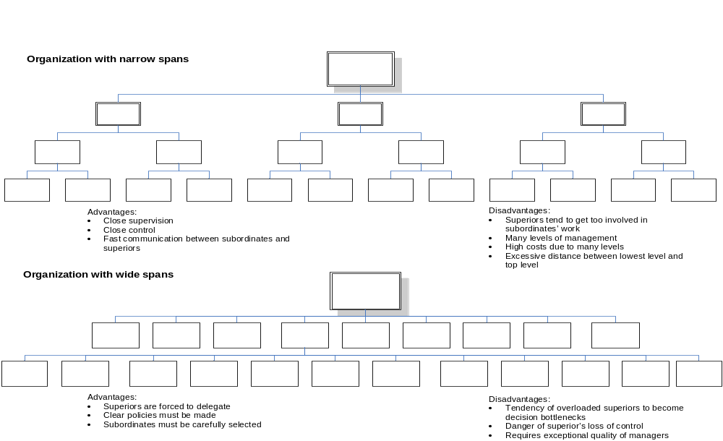
Organization Structures with Narrow and Wide Spans

Slide 12
Factors Determining an Effective Span
The number of subordinates a manager can effectively manage on the impact of underlying factors.
Aside from such personal capacities as comprehending quickly, getting along with people, and commanding loyalty and respect, the most important determinant is a manager’s ability to reduce the time he or she spends with subordinates.

Slide 13
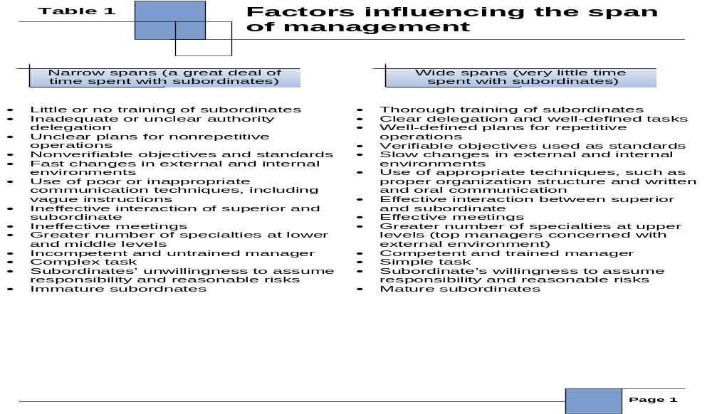
Factors Determining an Effective Span

Slide 14
Organization Structure
Departmentation by Enterprise Function
  It is the grouping of activities according to the functions of the enterprise, such as production, selling, and financing.

Slide 15
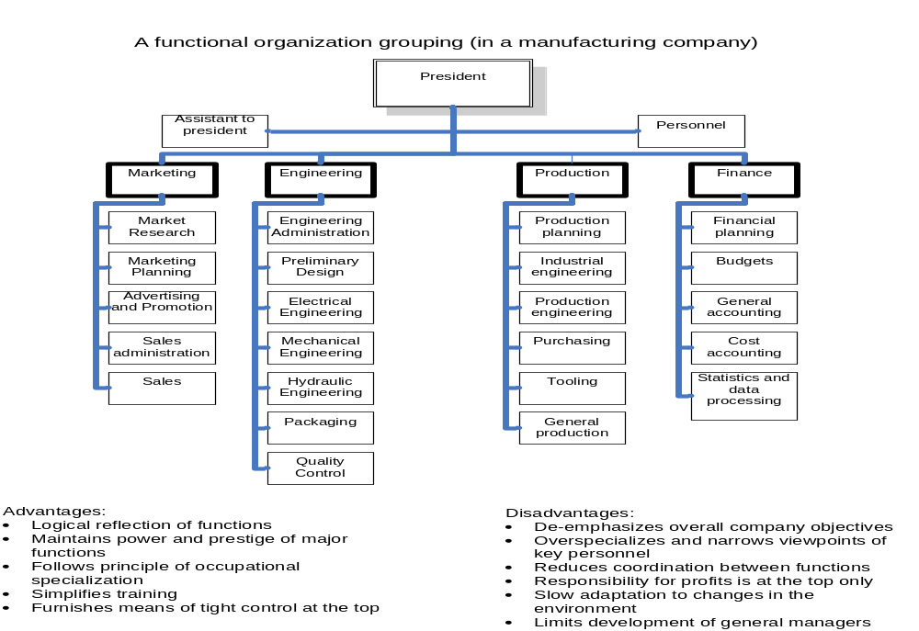
Organization Structure

Slide 16
Organization Structure
Departmentation by Territory or Geography
  It is the grouping of activities by area or territory that is common in enterprises operating over wide geographic areas.

Slide 17
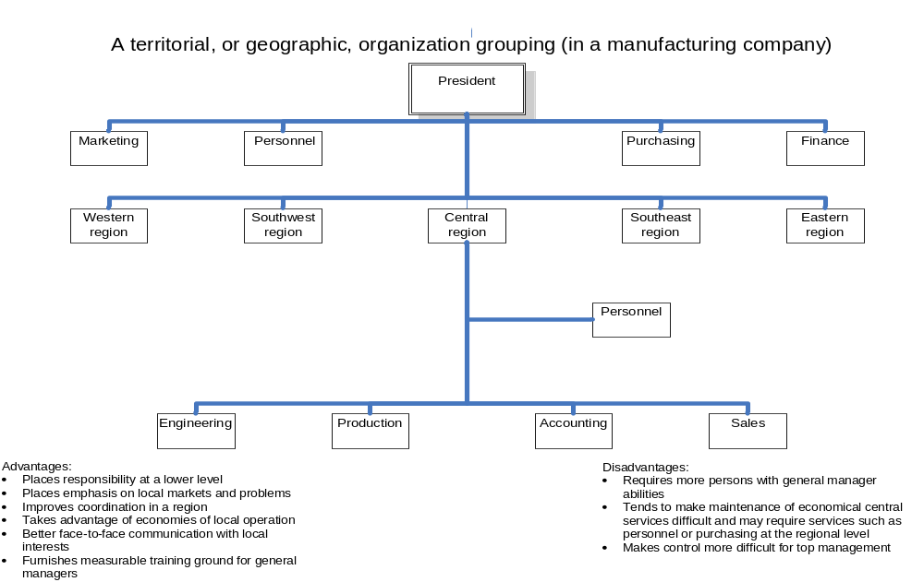
Organization Structure

Slide 18
Organization Structure
Departmentation by Customer Group
  It is the grouping of activities that reflects a primary interest in customers.

Slide 19
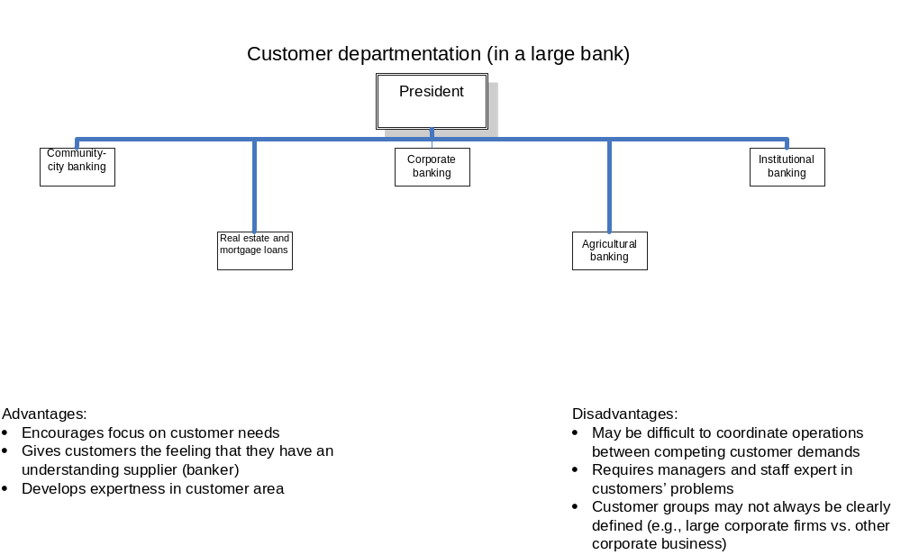
Organization Structure

Slide 20
Organization Structure
Departmentation by Product
  It is the grouping of activities according to products or product line, especially in multiline, large enterprises.

Slide 21
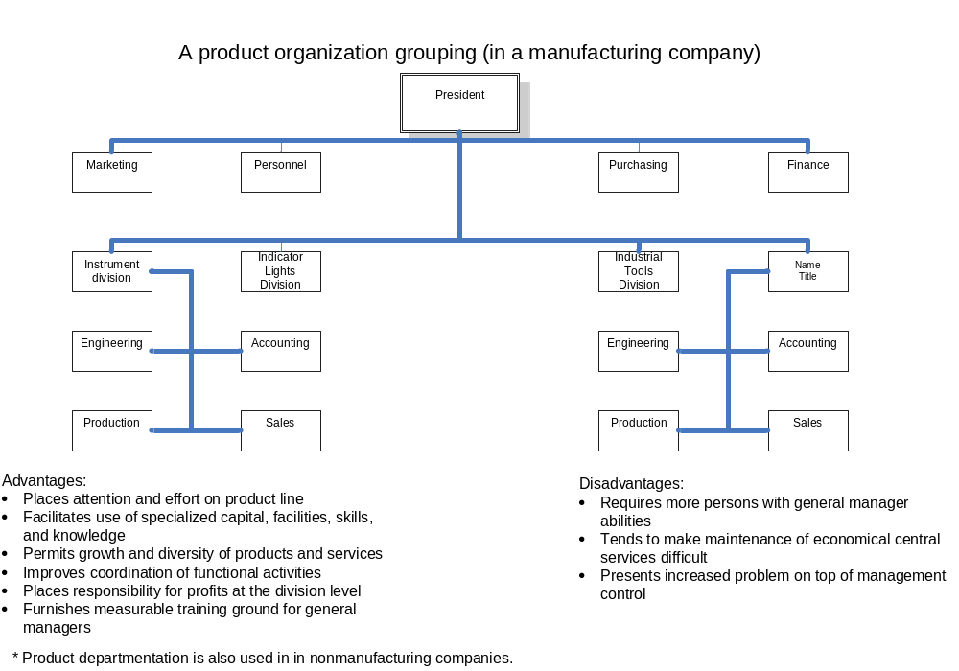
Organization Structure

Slide 22
Organization Structure
Matrix Organization
  It is the combining of functional and project or product patterns of departmentation in the same organization structure.

Slide 23
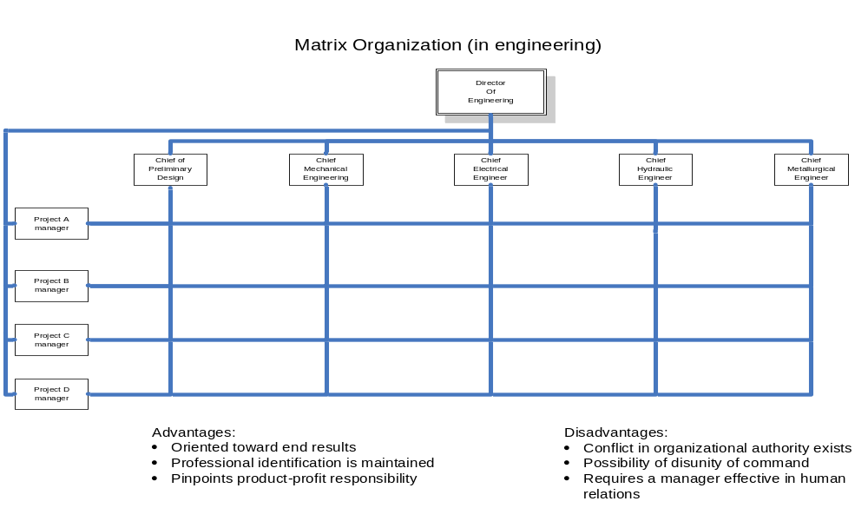
Organization Structure

Slide 24
Line / Staff Authority and Decentralization
Authority and Power
  Power is the ability of individuals or groups to induce or influence the beliefs or actions of other persons or groups.
  Authority is the right in a position to exercise discretion in making decisions affecting others.

Slide 25
Bases of Power
Legitimate Power
  It normally arises from and derives from our cultural system of rights, obligations, and duties whereby a “position” is accepted by people as being “legitimate”.
Expertness of a person or a group
  This is the power of knowledge. Physicians, lawyers, and university professors may have considerable influence on others because they are respected for their specialized knowledge.
Referent Power
  It is an influence that people or groups may exercise because people believe in them and their ideas.

Slide 26
Bases of Power
Reward Power
  It refers to the power that arises from the ability of some people to grant rewards.
Coercive Power
  It is the power to punish, whether by firing a subordinate or by withholding a merit pay increase.

Slide 27
Line / Staff Concepts and
Functional Authority
Scalar principle
  “The clearer the line of authority, the clearer will be the responsibility for decision making and the more effective will be organizational communication.”
Line authority
  The relationship in which a superior exercises direct supervision over a subordinate.
Staff relationship
  It’s nature is advisory.

Slide 28
Decentralization of Authority
  Decentralization is the tendency to disperse decision-making authority in an organized structure.

Slide 29
Delegation of Authority
Authority is delegated when a superior gives a subordinate discretion to make decisions.
Clearly, supervisors cannot delegate authority they do not have, whether they are members, presidents, vice presidents, or supervisors.

Slide 30
Delegation of Authority
The process of delegation involves:
  Determining the results expected from a position
  Assigning tasks to the position
  Delegating authority for accomplishing these tasks
  Holding the person in that position responsible for the accomplishment of the tasks.

Slide 31
The Art of Delegation
Personal Attitudes toward Delegation
  Receptiveness
    An underlying attribute of managers who will delegate authority is a willingness to give other people’s ideas a chance.
    Decision making always involves some discretion, and a subordinate’s decision is not exactly the one a superior would have made.

Slide 32
The Art of Delegation
Willingness to let go
  A manager who will effectively delegate authority must be willing to release them to make decisions to subordinates.
  A major fault of some managers who move up the executive ladder—or of the pioneer who has built a large business from the small beginning of, say, a garage machine shop—is that they want to continue making decisions for the positions they have left.

Slide 33
The Art of Delegation
Willingness to allow mistakes by subordinates
  Although no responsible manager would sit idly by and let a subordinate make a mistake that would endanger the company or the subordinate’s position in the company, continual checking on the subordinate to ensure that no mistakes are ever made will make true delegation impossible.
  Since everyone makes mistakes, a subordinate must be allowed to make some, and their cost must considered an investment in personal development.

Slide 34
The Art of Delegation
Willingness to trust subordinates
  Superiors have no alternative to trusting their subordinates, for delegation implies a trustful attitude between them.
Willingness to establish and use broad controls
  Since superiors cannot delegate responsibility for performance, they should not delegate authority unless they are willing to find means of getting feedback, that is, of assuring themselves that authority is being used to support enterprise or departmental goals and plans.

Slide 35
Three (3) Elements of Delegation
Responsibility – means that a person is assigned a task that he or she is supposed to carry out.
2. Authority – means that the person has the power and the right to give orders, draws upon resources, and do whatever else is necessary to fulfill the responsibility.
3. Accountability – means that the subordinate’s manager has the right to expect the subordinate to perform the job and to take corrective action in the event the subordinate fails to do so.

Slide 36
Recentralization of Authority and Balance as the Key to Decentralization
Recentralization is centralization of authority that was once decentralized; normally not a complete reversal of decentralization, as the authority delegated is not wholly withdrawn.

Slide 37
Staffing
It is defined as filling, and keeping filled, positions in the organizational structure.
Work specialization – degree to which the work necessary to achieve organizational goals is broken down into various jobs.
Job design – specification of task activities associated with a particular job (e.g. a job as an administrative assistant may include typing, filing and photocopying, or it could involve such activities as coordinating travels and meetings, investigating trouble spots, and making decisions about a certain range of issues).

Slide 38
Staffing
Approaches to Job Design
Job simplification – the process of designing jobs so that jobholders have only a small number of narrow activities to perform.
Job rotation – practice of periodically shifting workers through a set of jobs in a planned sequence.
Job enlargement – the allocation of a wider variety of similar tasks to a job in order to make it more challenging.
Job enrichment – process of upgrading the job-task mix in order to increase significantly the potential for growth, achievement, responsibility, and recognition.

Slide 39
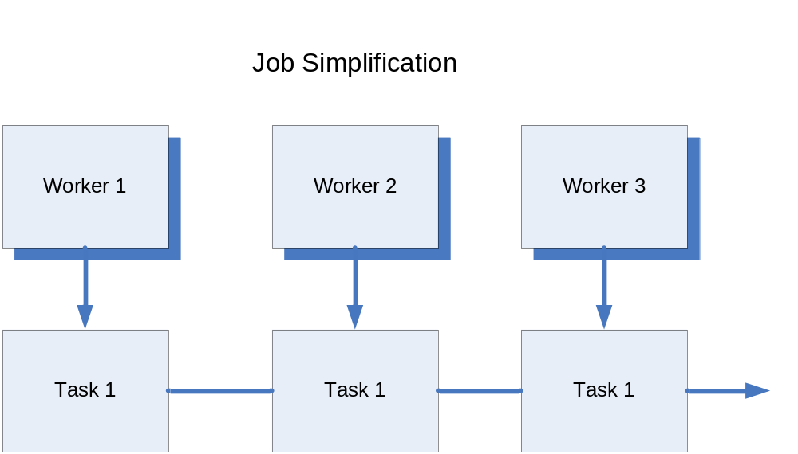
Job Simplification

Slide 40
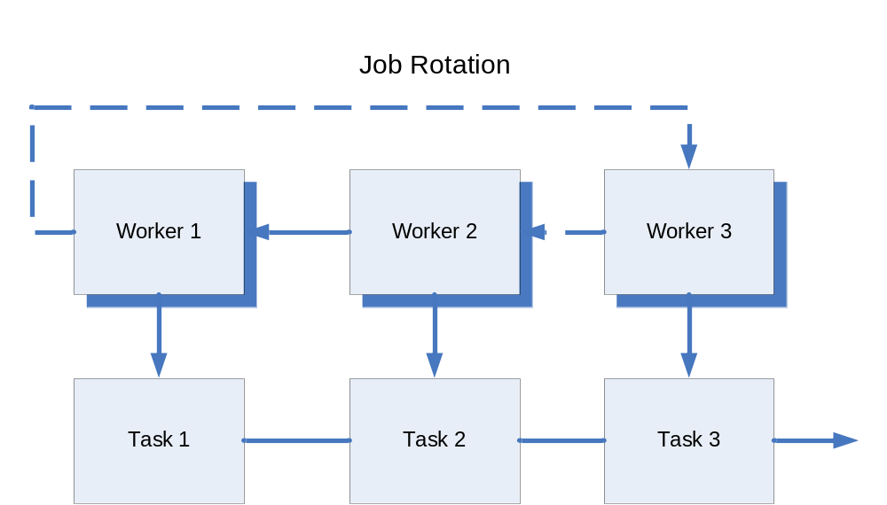
Job Rotation

Slide 41
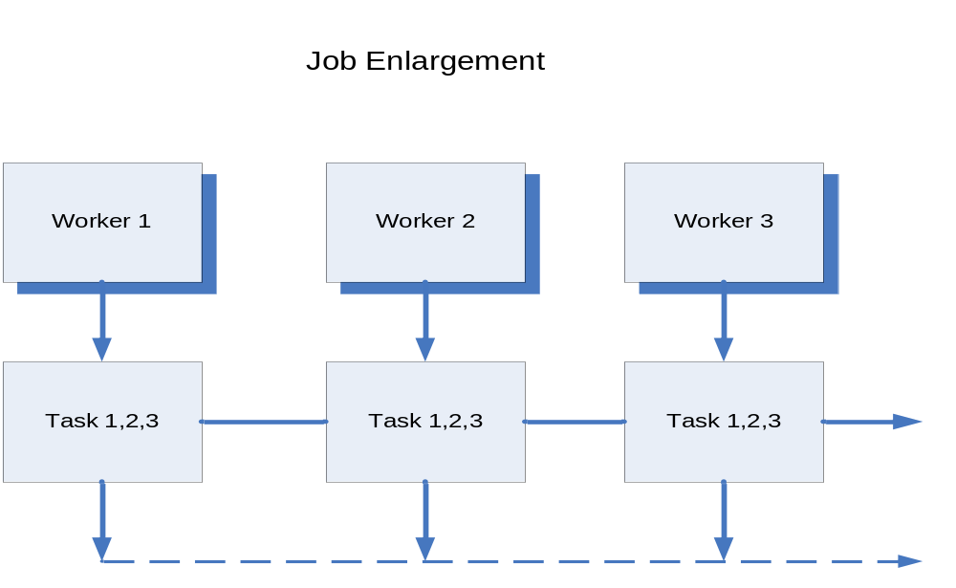
Job Enlargement

Slide 42
Movement of Personnel
RECRUITMENT is the process of encouraging, inducing, or influencing applicants to apply for a certain vacant position.
SELECTION is the process of getting the most qualified applicant from among different job seekers.
TRAINING is the systematic development of the attitude/knowledge/behaviour patterns for the adequate performance of a given job or task.
TRANSFER refers to the shifting of an employee from one position to another without increasing his duties, responsibilities, or pay.
PROMOTION refers to the shifting of an employee to a new position to which both his status and responsibilities are increased.

Slide 43
Movement of Personnel
OUTPLACEMENT is the process of helping people who have been dismissed from the company to regain employment elsewhere.
LAY-OFF is a type of separation, temporary and involuntary, usually traceable to a negative business condition
DISCHARGE is a permanent separation of an employee, at the will of an employer, if a person is not competent in his job, guilty of breaking rules like delinquency and insubordination, and other violations
RESIGNATION is voluntary and permanent separation of an employee due to due to low morale, low salary, etc.
RETIREMENT can either be voluntary or involuntary; if an employee retires upon reaching the number of years of services in a company as provided for by its policies or upon reaching the age of 65.
PERFORMANCE APPRAISAL is the process of defining, measuring, evaluating, and recording expectations from employee performance.

